Slide 1
Running Python on a UKMARSbot the easy way
David Hannaford
MINOS 2023

Slide 2
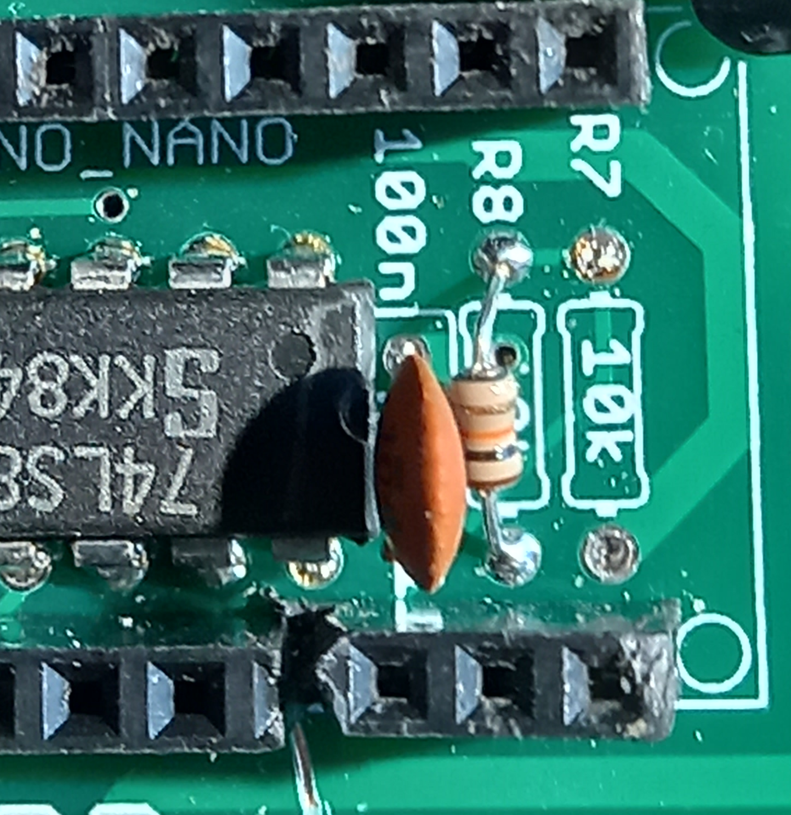
STEP 1 – Replace or leave out the R7 10KὨ resistor
This will stop the battery voltage/2 being fed to GP15 which could be above the 3.3v input pin voltage limit
Remove this resistor

Slide 3
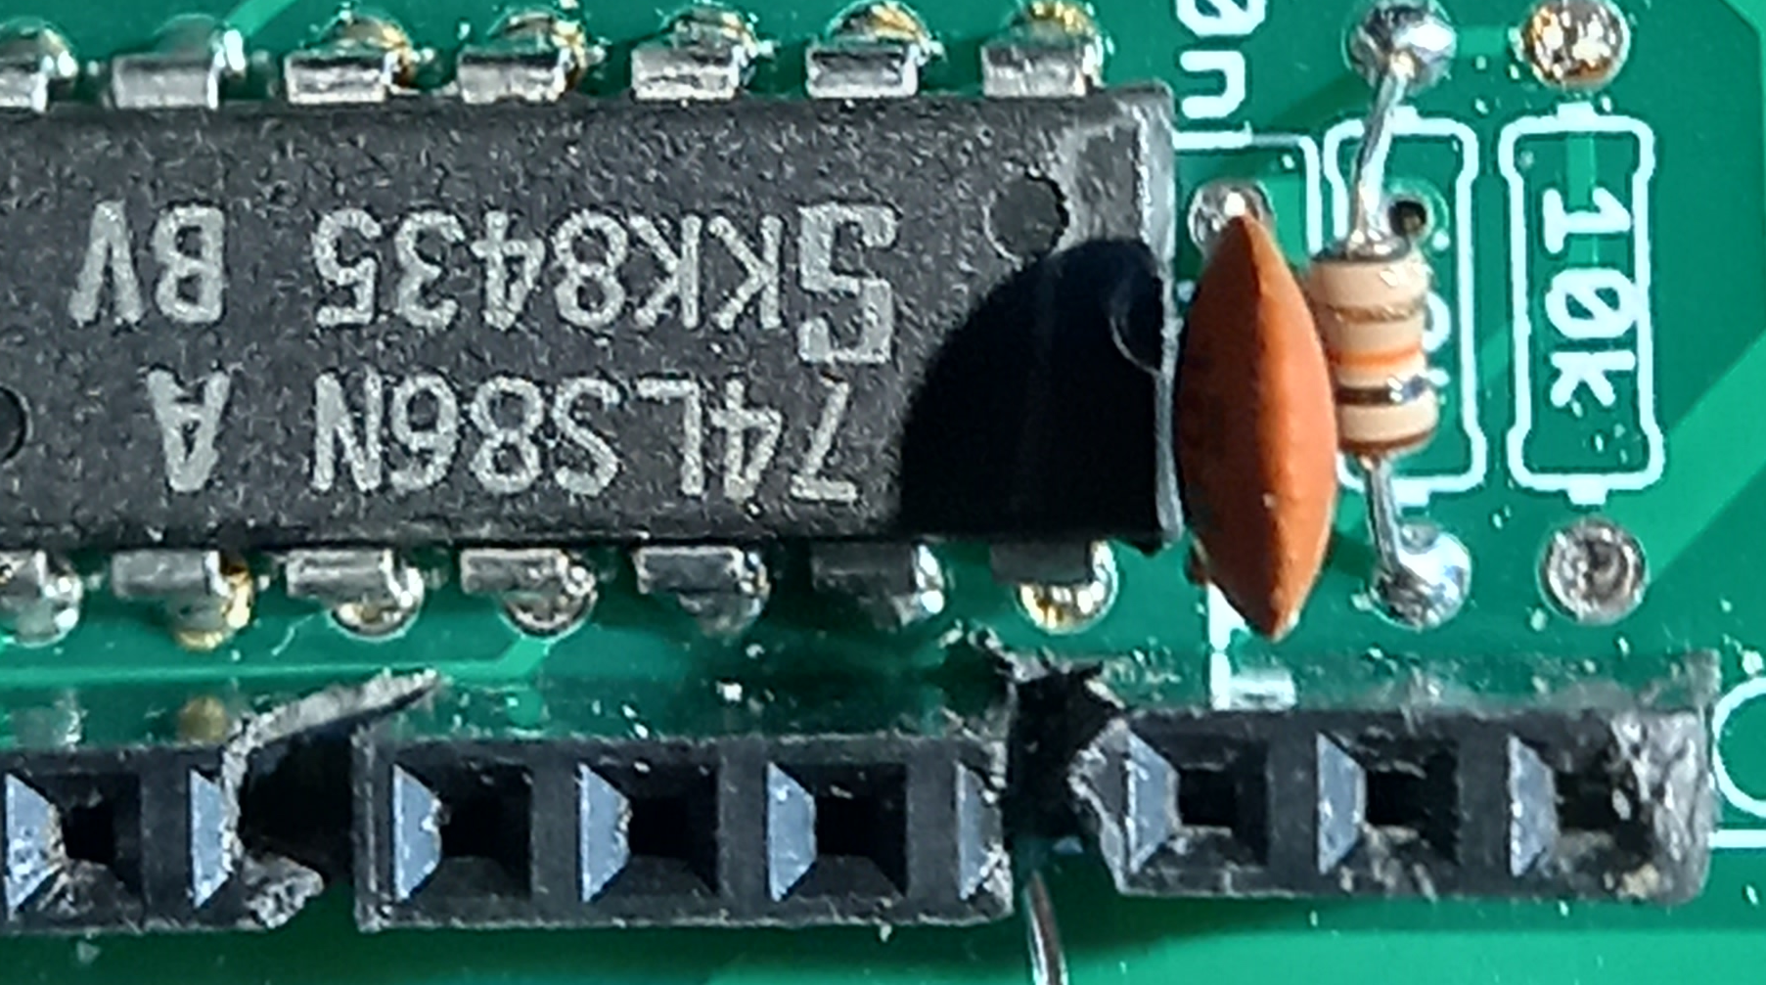
STEP 2 – Remove or leave out the 5v pin on the Arduino nano socket. This is the 4th one along from the end.
The easiest method is to put an 11 pin socket and a 3 pin socket instead of the normal 15 pin socket with a gap between them
This stops the 5V output from the board being fed into the PCB

Slide 4
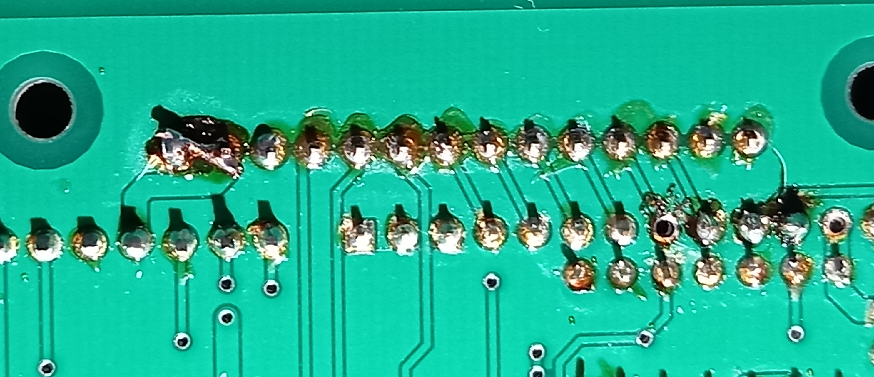
STEP 3 – On the underside of the board at the front, join together the 3.3V and 5V pin connections at the end of the row.
Join these
2 pins
This feeds the 3.3v output from the board to the 5V lines, so that everything that comes in will now be 3.3V maximum voltage

Slide 5
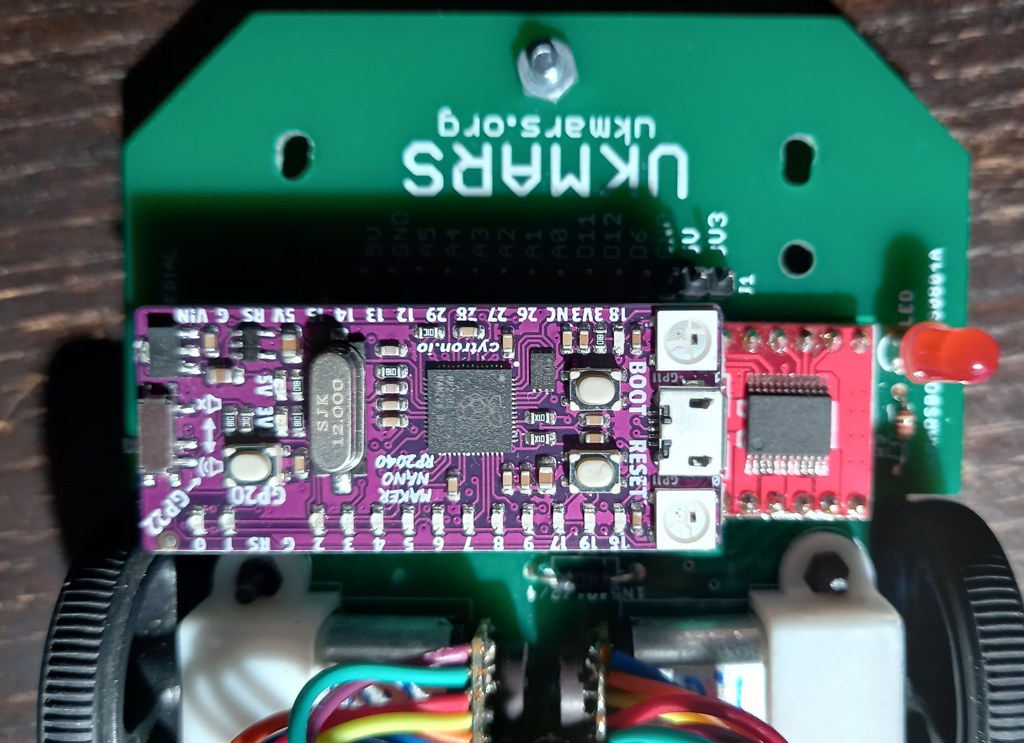
STEP 4 – STEP - Replace the Arduino nano with a Cytron Maker NANO RP2040 board
It plugs directly into the Arduino Nano socket
Available for £7.90 at Pi-Hut and many other sources

Slide 6
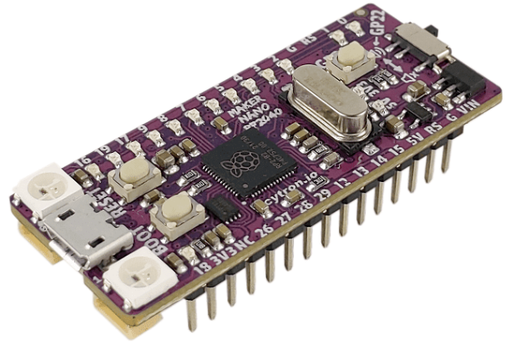
So what is the Cytron Maker NANO RP2040 board ?
It is a nano format board with a Raspberry Pi Pico RP2040 chip on it.
On this board you get :
A Raspberry pi RP2040 chip
14 blue LEDs on the digital pins
2 RGB LEDs
1 Piezo buzzer
1 user button
2Mb flash memory
264kb SRAM
125MHz clock speed
Vin 7- 32 V
3.3V operating voltage
500mA 3.3V output
22 digital IO pins
But just 4 12 bit ADCs

Slide 7
STEP 5 – Optionally replace the sensor board LED series resistors with a lower value as they will be driven from 3.3V instead of 5V.
However for line following they will probably run OK with the lower voltage.
The ADC input on the Cytron board is higher resolution than on the Arduino so this helps to compensate

Slide 8
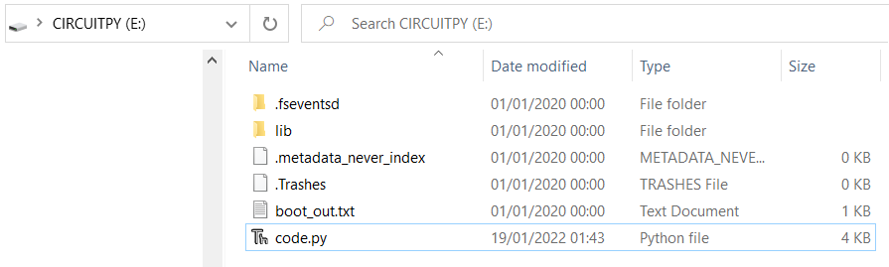
STEP 6 - Plug the RP2040 board into a USB port on your PC.
It will play a short tune then light up all the blue LEDs in turn
A new drive will open on your PC which should show you what is in the board’s storage
Sample code
If you have Thonny installed on your PC click on code.py
Otherwise download and install Thonny. The RP2040 comes with CircuitPython installed on it so after loading Thonny click on Run / Select interpreter/ CircuitPython (generic)

Slide 9
You can now write and run python on your UKMARSbot
However, CircuitPython has non standard input and output commands and does not support interrupts, so it is a good move to reload the board with standard MicroPython.
To do this, go to:
https://micropython.org/download/rp2-pico/
Download the latest version - probably v1.19.1 (2022-06-18) .uf2 [
Hold down the BOOT button on the RP2040 board while plugging the board into USB port on you PC. Copy the downloaded uf2 file to the USB mass storage device that appears. Once programming of the new firmware is complete the device will automatically reset and be ready for use. You now have MicroPython installed. In Thonny click on Run / Select interpreter/ MicroPython (Raspberry Pi Pico)

Slide 10
Comparison of MicroPython and CircuitPython I/O commands
 | MicroPython | CircuitPython
Board commands including Digital in and out, ADC and PWM | from machine import Pin, ADC, PWM | import board from digitalio import DigitalInOut, Direction, Pull from analogio import AnalogIn import pwmio
Define digital input - with pull up | btn1 = machine.Pin(20, Pin.IN, Pin.PULL_UP) | btn1 = DigitalInOut(board.GP20) btn1.direction = Direction.INPUT btn1.pull = Pull.UP
Define digital output | LED_PIN = Pin(18, Pin.OUT) | LED_PIN = DigitalInOut(board.GP18) LED_PIN.direction = Direction.OUTPUT
Define ADC input | Lsidesense = ADC(Pin(29)) | Lsidesense = AnalogIn(board.A3)
Define PWM output | LMOTOR_PWM = machine.PWM(machine.Pin(9)) LMOTOR_PWM.freq(1000) | LMOTOR_PWM = pwmio.PWMOut(board.GP9, frequency=1000, duty_cycle=0)
Digital input read | setting = btn1.value() | Setting = btn1.value
Digital output write | LED_PIN.value(True) | LED_PIN.value = True
ADC read | leftside = Lsidesense.read_u16() | leftside = Lsidesense.value
PWM speed output | LMOTOR_PWM.duty_u16(3000) | LMOTOR_PWM.duty_cycle = 3000

Slide 11
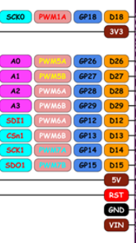
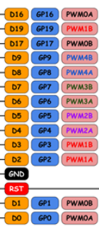
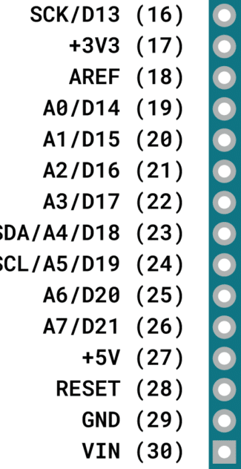
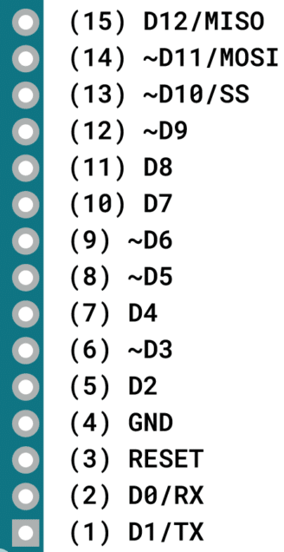
PIN mappings between Arduino nano and Maker RP2040
Maker RP2040
Arduino Nano
Arduino Nano
Maker RP2040

Slide 12
Arduino Nano UKMARSbot pin usage RP2040 equivalent placed pins
A0; left side sensor input D26 Analog input OK
A1; front left line sensor input D27 Analog input OK
A2; front right left sensor input D28 Analog input OK
A3; right side sensor input D29 Analog input OK
A4; unassigned sensor input 1 D12 Digital input from sensor board
A5; unassigned sensor input 2 D13 Digital input from sensor board
A6; input from four way switch switch D14 Digital input only but button works
A7; / input for battery measurement D15 Need to disconnect
D0; Receive pin D1 use for Bluetooth
D1; Transmit pin D0 use for Bluetooth
D2; motor 1 encoder 1 input interrupt pin D2 OK
D4; motor 1 encoder 2 input D4 OK
D3; motor 2 encoder 1 input interrupt pin D3 OK
D5; motor 2 encoder 2 input D5 OK
Output pins:
D6; 1st diagnostic LED on sensor board D6 OK
D7; Left motor dirn input 1 D7 OK
D8; Right motor dirn input 3 D8 OK
D9; Left motor PWM pin D9 OK
D10; Right motor PWM pin D17 OK
D11; 2nd diagnostic LED on sensor board D19 OK
D12; trigger for sensor LEDs D16 OK
D13; ext LED Red D18 OK

Slide 13
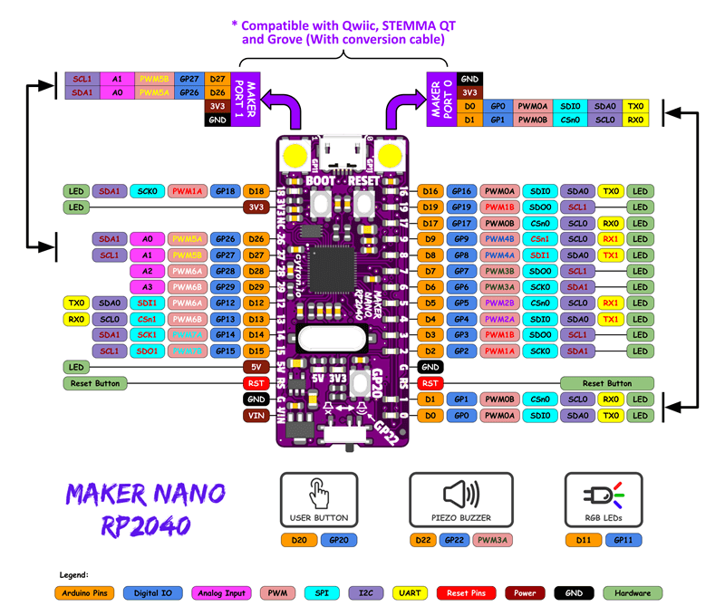
The RP2040 Pin out

Slide 14
MicroPython pin definitions for UKMARSBOT – page 1
# pin definitions
# Set pins for digital outputs on Maker Pi RP2040
LED_PIN = Pin(18, Pin.OUT) # ext LED on GP18
SENSOR1_PIN = Pin(19, Pin.OUT) # 1st Sensor LED on line follow sensor board
SENSOR2_PIN = Pin(6, Pin.OUT) # 2nd Sensor LED on line follow sensor board
TRIGGER_PIN = Pin(16, Pin.OUT) # Trigger for LEDs on line follow sensor board
RMOTOR_DIR = Pin(8, Pin.OUT)
LMOTOR_DIR = Pin(7, Pin.OUT)
PIEZO_PIN = Pin(22, Pin.OUT) # Pin connected to piezo buzzer
#define PWM motor speed pins
#LMOTOR = machine.Pin(9) # left motor is pin 9
#MOTOR = machine.Pin(17) # right motor is pin 17
LMOTOR_PWM = machine.PWM(machine.Pin(9))
RMOTOR_PWM = machine.PWM(machine.Pin(17))
LMOTOR_PWM.freq(1000)
RMOTOR_PWM.freq(1000)
LMOTOR_PWM.duty_u16(0) # left motor speed - range is 0 to 65535
RMOTOR_PWM.duty_u16(0) # right motor speed - range is 0 to 65535

Slide 15
MicroPython pin definitions for UKMARSBOT – page 2
# Define analogue inputs used on sensor board
Lsidesense = ADC(Pin(29)) # A3
Lfrontsense = ADC(Pin(28)) # A2
Rfrontsense = ADC(Pin(27)) # A1
Rsidesense = ADC(Pin(26)) # A0
# Define on-board button with pull up so it goes false when pressed
btn1 = machine.Pin(20, Pin.IN, Pin.PULL_UP)
Leftenc1 = Pin(2, Pin.IN) # encoder pins
Leftenc2 = Pin(4, Pin.IN)
Rightenc1 = Pin(3, Pin.IN)
Rightenc2 = Pin(5, Pin.IN)
SensorD1 = Pin(12, Pin.IN) # spare digital input on A4 pin
SensorD2 = Pin(13, Pin.IN) # spare digital input on A5 pin
Funcsw = Pin(14, Pin.IN) # function switch digital input
Battery = Pin(15, Pin.IN) # battery voltage not connected
# Initialize Neopixel RGB LEDs
#pixels = neopixel.NeoPixel(11,Pin.OUT, 2)
#pixels.fill(0)
Note: If you want to use the button on the PCB, set the switches to all on

Slide 16
Statements needed for UKMARSbot
Place these import statements at the start of your Python program:
from machine import Pin, ADC, PWM
import neopixel
import time
Then put the pin assignments as shown on the 2 previous slides
def photoread():
global leftside, leftfront, rightfront, rightside
TRIGGER_PIN.value(1) # switch on LEDs on sensor board
time.sleep(0.02) # wait for LEDs to light up
leftside = Lsidesense.read_u16() # read left side sensor
leftfront = Lfrontsense.read_u16() # read left front sensor
rightfront = Rfrontsense.read_u16() # read right front sensor
rightside = Rsidesense.read_u16() # read right side sensor
TRIGGER_PIN.value(0) # switch off LEDs on sensor board
return
Then write the procedure definitions e.g.
Then your line follower or other code

Slide 17
Save the program to the board with name main.py
(if using CircuitPython call it code.py)
This will run automatically when you power up the board or press the reset button
Good Luck

Slide 18
from machine import Pin, ADC, PWM
import neopixel
import time
# Global variable definitions
global leftside, leftfront, rightfront, rightside
global l1count, l2count, r1count, r2count, prevleft1, prevleft2, prevright1, prevright2
global bit0, bit1, bit2, bit3
# pin definitions
# Set pins for digital outputs on Maker Pi RP2040
LED_PIN = Pin(18, Pin.OUT) # ext LED on GP18
SENSOR1_PIN = Pin(19, Pin.OUT) # 1st Sensor LED on line follow sensor board
SENSOR2_PIN = Pin(6, Pin.OUT) # 2nd Sensor LED on line follow sensor board
TRIGGER_PIN = Pin(16, Pin.OUT) # Trigger for LEDs on line follow sensor board
RMOTOR_DIR = Pin(8, Pin.OUT)
LMOTOR_DIR = Pin(7, Pin.OUT)
PIEZO_PIN = Pin(22, Pin.OUT) # Pin for piezo buzzer
#define PWM motor speed pins
#LMOTOR = machine.Pin(9) # left motor is pin 9
#MOTOR = machine.Pin(17) # right motor is pin 17
LMOTOR_PWM = machine.PWM(machine.Pin(9))
RMOTOR_PWM = machine.PWM(machine.Pin(17))
LMOTOR_PWM.freq(2000)
RMOTOR_PWM.freq(2000)
LMOTOR_PWM.duty_u16(0) # left motor speed - range is 0 to 65535
RMOTOR_PWM.duty_u16(0) # right motor speed - range is 0 to 65535
# Define analogue inputs used on sensor board
Lsidesense = ADC(Pin(29)) # A3
Lfrontsense = ADC(Pin(28)) # A2
Rfrontsense = ADC(Pin(27)) # A1
Rsidesense = ADC(Pin(26)) # A0

Slide 19
# Define RP2040 on-board button with pull up so it goes false when pressed
btn1 = machine.Pin(20, Pin.IN, Pin.PULL_UP)
# define press button switch on UKMARS board next to 4 way switch which should be set to all on
Switch = Pin(14, Pin.IN) # button / switch pin
Leftenc1 = Pin(2, Pin.IN) # encoder pins
Leftenc2 = Pin(4, Pin.IN)
Rightenc1 = Pin(3, Pin.IN)
Rightenc2 = Pin(5, Pin.IN)
#pixels = neopixel.NeoPixel(11,Pin.OUT, 2)
#pixels.fill(0)
def photoread():
global leftside, leftfront, rightfront, rightside
TRIGGER_PIN.value(1) # switch on LEDs on sensor board
time.sleep(0.02)
leftside = Lsidesense.read_u16()
leftfront = Lfrontsense.read_u16()
rightfront = Rfrontsense.read_u16()
rightside = Rsidesense.read_u16()
TRIGGER_PIN.value(0)
return
# here are the definitions for the procedures used
def phototest():
while True:
global leftside, leftfront, rightfront, rightside
photoread()
print((leftside),(leftfront),(rightfront),(rightside),)
time.sleep(.5) # white 4,500, black 55,000
return
def switchread():
global swvalue
swvalue = Switch.value() # = 0, or 1
def switchtest():
while True:
global swvalue
switchread()
print(("switch"),(swvalue))
time.sleep(.5) #

Slide 20
def progdisp():
global swvalue, progno
switchread()+
if(swvalue == 1):
progno = progno + 1
time.sleep(.5)
p1count = progno
progno = p1count - (int(p1count / 8) * 8) # this gets it in range 0 to 7
bit2 = p1count - (int(p1count / 2) * 2) # this extracts bit 3
p1count = int(p1count / 2)
bit1 = p1count - (int(p1count / 2) * 2) # this extracts bit 2
p1count = int(p1count / 2)
bit0 = p1count - (int(p1count / 2) * 2) # this extracts bit 1
p1count = int(p1count / 2)
if (bit0 == 1):
SENSOR1_PIN.value(True)
else:
SENSOR1_PIN.value(False)
if (bit1 == 1):
SENSOR2_PIN.value(True)
else:
SENSOR2_PIN.value(False)
if (bit2 == 1):
LED_PIN.value(True)
else:
LED_PIN.value(False)
def encoderread():
global lefte1, lefte2, righte1, righte2
lefte1 = Leftenc1.value
lefte2 = Leftenc2.value
righte1 = Rightenc1.value
righte2 = Rightenc2.value
def encodertest():
global lefte1, lefte2, righte1, righte2, l1count, l2count, r1count, r2count
while True:
encoderread()
print((l1count), (l2count), (r1count), (r2count),)
time.sleep(.5)
return

Slide 21
def encountdisp():
global l1count, l2count, r1count, r2count
global bit0, bit1, bit2, progno
p1count = int(l1count / 8)
progno = p1count - (int(p1count / 8) * 8) # this gets it in range 0 to 7
bit2 = p1count - (int(p1count / 2) * 2) # this extracts bit 3
p1count = int(p1count / 2)
bit1 = p1count - (int(p1count / 2) * 2) # this extracts bit 2
p1count = int(p1count / 2)
bit0 = p1count - (int(p1count / 2) * 2) # this extracts bit 1
p1count = int(p1count / 2)
if (bit0 == 1):
SENSOR1_PIN.value(True)
else:
SENSOR1_PIN.value(False)
if (bit1 == 1):
SENSOR2_PIN.value(True)
else:
SENSOR2_PIN.value(False)
if (bit2 == 1):
LED_PIN.value(True)
else:
LED_PIN.value(False)
# print (l1count, progno, bit0, bit1, bit2,)
def leftcount():
global lefte1, lefte2, righte1, righte2, l1count, l2count, r1count, r2count
l1count = l1count+1
l2count = l2count+1
return
def rightcount():
global lefte1, lefte2, righte1, righte2, l1count, l2count, r1count, r2count
r1count = r1count+1
r2count = r2count+1
return

Slide 22
if (sensordiff > 40000):
sensordiff = 40000
if (sensordiff < -40000):
sensordiff = - -40000
if ((leftfront > 20000) and (rightfront > 20000)): # gone off the line
if (side == 1):
adjustment = 5000
if (side == 2):
adjustment = -5000
else: # proportional control
adjustment = sensordiff
if (leftfront > rightfront):
side = 1
if (rightfront > leftfront):
side = 2
adjustment = adjustment + dterm
leftspeed = int(basespeed + adjustment)
rightspeed = int(basespeed - adjustment)
checkspeed()
LMOTOR_PWM.duty_u16(leftspeed)
RMOTOR_PWM.duty_u16(rightspeed)
prevdiff = sensordiff
# Line follower code
def widelinefollow():
global leftfront, rightfront, leftspeed, rightspeed
basespeed = 8000 - slowdownby
side = 0
adjustment = 0
prevdiff = 0
while True:
photoread()
if (leftfront < 10000): # put LED indics on
SENSOR1_PIN.value(True)
else :
SENSOR1_PIN.value(False)
if (rightfront < 10000):
SENSOR2_PIN.value(True)
else :
SENSOR2_PIN.value(False)
sensordiff = (leftfront - rightfront) / 6
dterm = (sensordiff - prevdiff) * 3

Slide 23
def checkspeed():
global leftspeed, rightspeed
if leftspeed > 50000:
leftspeed = 50000
if rightspeed > 50000:
rightspeed = 50000
if leftspeed < 10:
leftspeed = 10
if rightspeed < 10:
rightspeed = 10
return
# ------- End of procedure definitions ---------------
# code runs from here
LED_PIN.value(1) # switch on LED
SENSOR1_PIN.value(1) # switch on sensor1 LED
SENSOR2_PIN.value(1) # switch on sensor2 LED
RMOTOR_DIR.value(1) # set the right motor direction
LMOTOR_DIR.value(1) # set the left motor direction
#color = 0
#state = 0
# Play tone
PIEZO_PWM = machine.PWM(machine.Pin(22))
PIEZO_PWM.freq(440)
PIEZO_PWM.duty_u16(30000) # in range 0 to 65535
time.sleep(0.5)
PIEZO_PWM.duty_u16(0)
l1count = l2count = r1count = r2count = 0 #reset the encoder counts
left1 = left2 = right1 = right2 = True
prevleft1 = prevleft2 = prevright1 = prevright2 = True # reset the previous encoder values
progno = 0
swvalue = 0

Slide 24
# configure irq callback
Leftenc1.irq(lambda p:leftcount())
Rightenc1.irq(lambda p:rightcount())
# -------------------------------------------------
# wait for onboard button to be pressed
setting = 1
while (setting == True): # Check button 1 (GP20)
setting = btn1.value()
#print ("progno", progno)
progdisp()
#encountdisp()
time.sleep(0.1)
slowdownby = 0
# run selected program
if (progno == 0):
widelinefollow()
if (progno == 1):
phototest()
if (progno == 2):
encodertest()
SENSOR1_PIN.value(0) # switch off sensor1 LED on line folllower board
SENSOR2_PIN.value(0) # switch off sensor2 LED on line folllower board
LMOTOR_PWM.duty_u16(0) # in range 0 to 65535
RMOTOR_PWM.duty_u16(0)

Slide 25
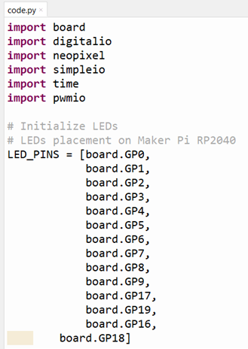
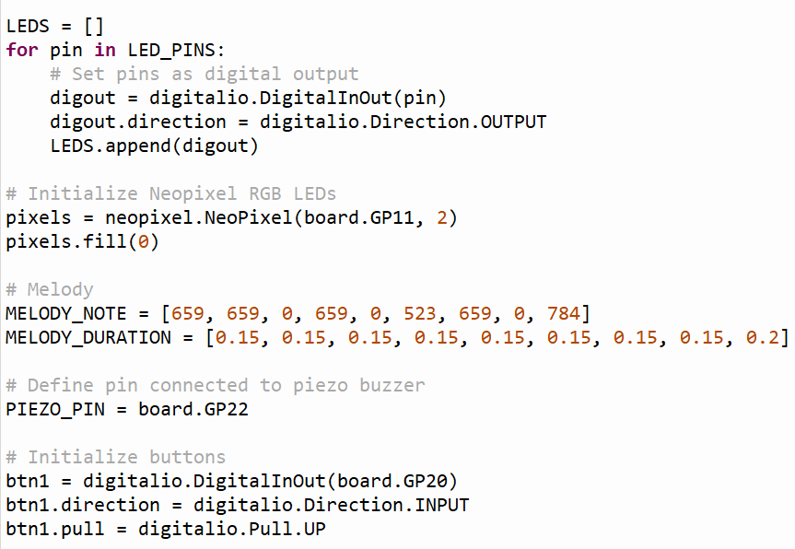
This is the code.py program that code on the board when bought
Note that this is using the CircuitPython syntax

Slide 26
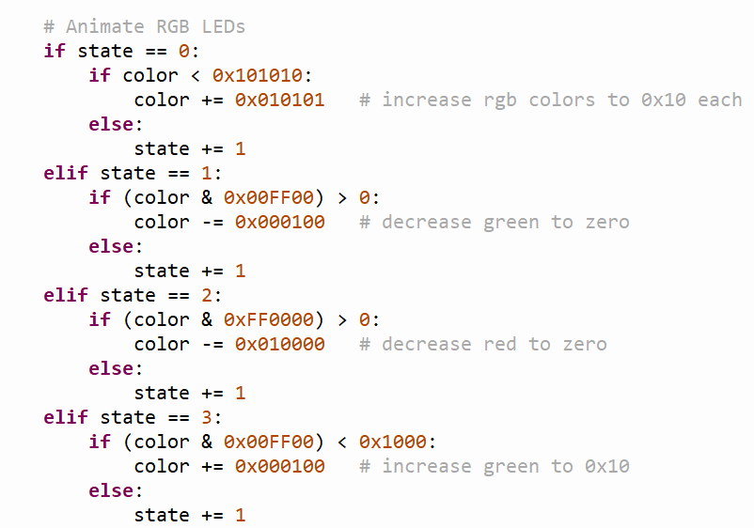
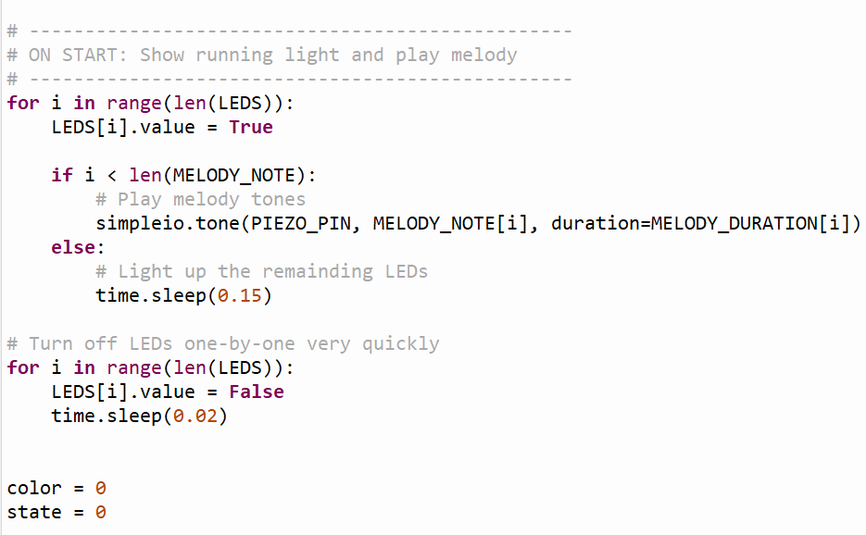
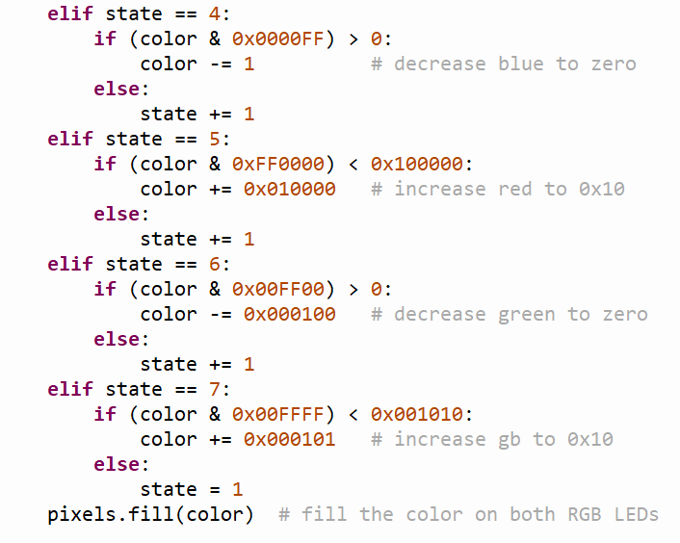
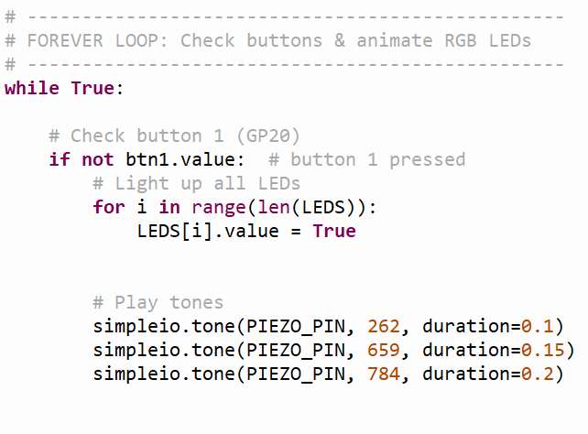

Slide 27
To run a program under CircuitPython
Copy it to the drive on the board – e.g. drive (E:) for me
Rename it as main
Restart the board and the main program will run

